Slide 1
Chapter 12: Negative Reinforcement

Slide 2
Definition
Stimulus removed (terminated, reduced, or postponed)
Contingent on a response
Which results in an increase in the future probability of that response

Slide 3
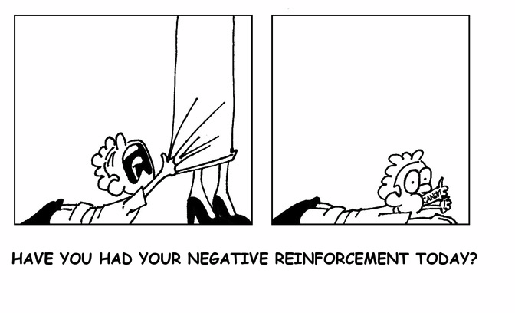
Application

Slide 4
Positive vs. Negative Reinforcement
How they are similar:
Both produce an increase in responding via a stimulus change
How they are different:
The type of stimulus change that follows the behavior
Positive reinforcement produces a stimulus that was absent prior to responding
Negative reinforcement terminates a stimulus that was present prior to responding

Slide 5
Positive vs. Negative Reinforcement
Positive reinforcement:
EO
Absence of food for 2 hours
S^{D}
Teacher says “Snack time” and apples on table
Response
“Apple, please”
S^{R+}
Apple presented
Saying “Apple, please” when it is snack time and apples are present more likely in the future
Different
Similar
Negative reinforcement:
EO
Math worksheet with 20 problems on student’s desk
S^{D}
Teacher says “Complete 5 problems, then you don’t have to do the rest”
Response
Completes 5 problems
S^{R-}
Remaining problems on worksheet removed
Completing problems when math worksheet and teacher instructions present more likely in the future

Slide 6
A difficulty…
Sometimes it can be difficult to determine whether the stimulus change was positive or negative
Turning up the heat
Adds heat
Removes cold
Free time contingent on work completion
Adds preferred activities
Removes work

Slide 7
A solution…
Michael (1975) suggested the distinction is not important
Instead, define key stimulus features
Before the stimulus change
After the stimulus change
This may provide a more complete, functional understanding of the relationship between the behavior and environment

Slide 8
Negative Reinforcement vs. Punishment
Often confused because:
“Positive” and “Negative” are opposites
But “positive” refers to presentation of the stimulus and “negative” refers to the termination of the stimulus

Slide 9
Negative Reinforcement vs. Punishment
Both involve “aversive” events
But in negative reinforcement, the aversive event is present prior to the target behavior and in punishment, the aversive event is presented contingent on the target behavior
And the effect on behavior is different (negative reinforcement produces an increase in responding; punishment produces a decrease in responding)

Slide 10
Negative Reinforcement vs. Punishment
Negative reinforcement:
EO
Math worksheet with 20 problems on student’s desk
S^{D}
Teacher says “Complete 5 problems, then you don’t have to do the rest”
Response
Completes 5 problems
S^{R-}
Remaining problems on worksheet removed
Completing problems more likely in the future when math worksheet and teacher instructions present
Different
Aversive stimuli
Punishment:
S^{D}
Teacher says “Complete 5 problems, then you don’t have to do the rest”
Response
Destroys worksheet
S^{P+}
Teacher requires student to complete all 20 problems
Destroying worksheet less likely in the future when teacher makes work request
Notes:
There is no EO listed in the punishment diagram because Eos and Aos pertain reinforcement effects.

Slide 11
Escape and Avoidance Contingencies
Escape Contingency
EO
Rain falling on your head as you walk down sidewalk
S^{D}
Friend says “Do you have an umbrella?”
Response
Put up umbrella
S^{R-}
Escape rain falling on your head
Putting up umbrella more likely in the future when it’s raining and friend asks for umbrella

Slide 12
Escape Contingency
Includes 4 terms
Establishing operation
Antecedent event in the presence of which escape is reinforcing
An aversive stimulus
A discrimintive stimulus (S^{D})
A response
The reinforcer (termination of the EO)

Slide 13
The Escape Contingency
Reinforcement by the removal of an aversive stimulus.
Before
Make eye contact with Ex.
Behavior
Politely say “hi” and say you’re running late.
After
Leave location with Ex.

Slide 14
Escape and Avoidance Contingencies
Avoidance Contingency
EO
Rain outside; you are still inside--nice and dry
S^{D}
Friend says “Do you have an umbrella?”
Response
Put up umbrella (prior to going outside)
S^{R-}
Avoid rain falling on your head
Putting up umbrella more likely in the future when it’s raining and friend asks for umbrella

Slide 15
The Avoidance Contingency
Reinforcement by preventing an aversive stimulus from occurring
Typically accompanied by a warning stimulus
Stimulus that signals forthcoming of aversive
Before
Ex is seen across room
Behavior
Walk to different room.
After
Avoid conversation with Ex.

Slide 16
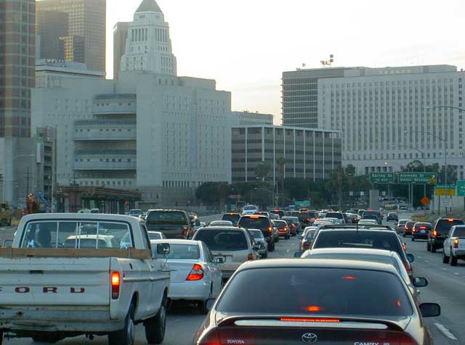
APPLICATION
You’re stuck in a traffic jam and will exit at the next exit to take side streets
What contingency?

Slide 17
APPLICATION
Your GPS notifies you there’s a traffic jam in the next 5 miles. You decide to take the next exit to take side streets the rest of the way.
What contingency?

Slide 18
Characteristics of Negative Reinforcement
Any response (socially appropriate or inappropriate) can be strengthened by negative reinforcement
All are adaptive because they allow the individual to interact effectively with the environment
A variety of stimuli can serve as negative reinforcers
Unconditioned
Conditioned

Slide 19
Characteristics of Negative Reinforcement
Negative reinforcement can be
Socially mediated (delivered by another person)
Automatic (is produced directly by the person’s response)

Slide 20
Factors Influencing Effectiveness
As with positive reinforcement, negative reinforcement is most effective when
It is delivered immediately following the target behavior
The magnitude of reinforcement is large
It is delivered consistently
Reinforcement is unavailable for competing (nontarget) responses

Slide 21
Ethical Considerations
Like positive reinforcement, ethical issues arise from the severity of the EO that may need to be in place to motivate the occurrence of the behavior
The presence of particularly aversive antecedent stimuli may be problematic
These stimuli may generate undesirable competing behaviors

Slide 22
Scenario:
Stan sees a child pass the cookie aisle in target. The child then begins screaming and crying. His mom then takes a box of cookies off the shelf and puts them in the basket. As a result, the child stops crying.
Before
Behavior
After
Notes:
Stan sees cookies→screams/cries-->gets cookies

Slide 23
Scenario- Now from Mom’s POV:
Stan sees a child pass the cookie aisle in target. The child then begins screaming and crying. His mom then takes a box of cookies off the shelf and puts them in the basket. As a result, the child stops crying.
Before
Behavior
After
Notes:
Mom hears cries-->gives cookies-->Crying stops

Slide 24
Let’s Practice
DIAGRAM THIS:
Professor sees a penny on the ground. She picks up the penny and then finds 20 dollars in a bush. As a result, she picks up every penny she sees.
Notes:
See penny-->pick it up→find $20

Slide 25
Let’s Practice
DRAW THIS:
Aaron does not like Justin Bieber. When he came on the radio, Aaron turned the station. As a result Justin Bieber no longer was playing.
Notes:
Hear Justin Bieber-->change station→Justin Bieber gone

